Slide 1

Bank++
Nathaniel Jaime

Slide 2
What is Bank++?
Bank++ is a Salesforce Application that allows bank users to make:
Customer Accounts
Contacts
Loans
And their respective transactions

Slide 3
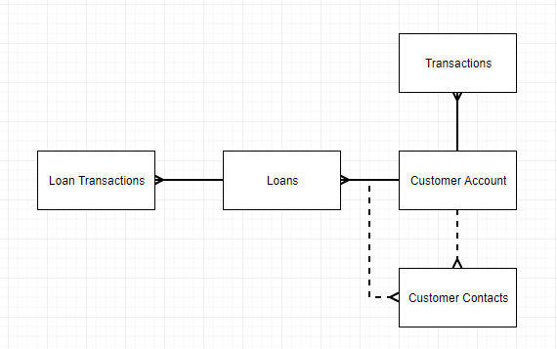
ERD

Slide 4
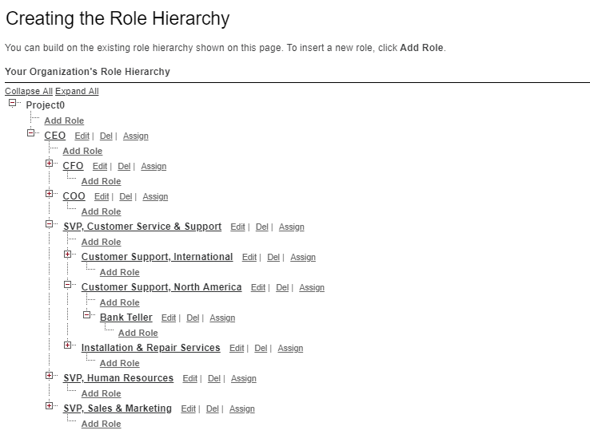
Used Role Hierarchy to allow the Bank Teller user to only see what they need to see.

Slide 5
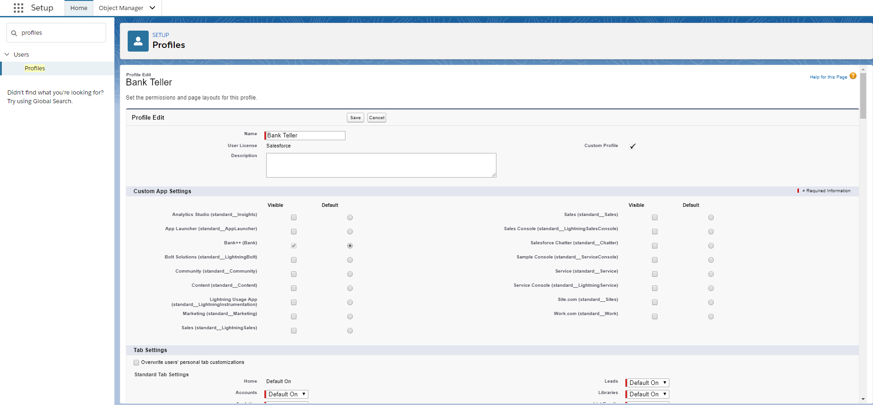
Used Profiles to restrict object access to only the core operations of Bank++

Slide 6
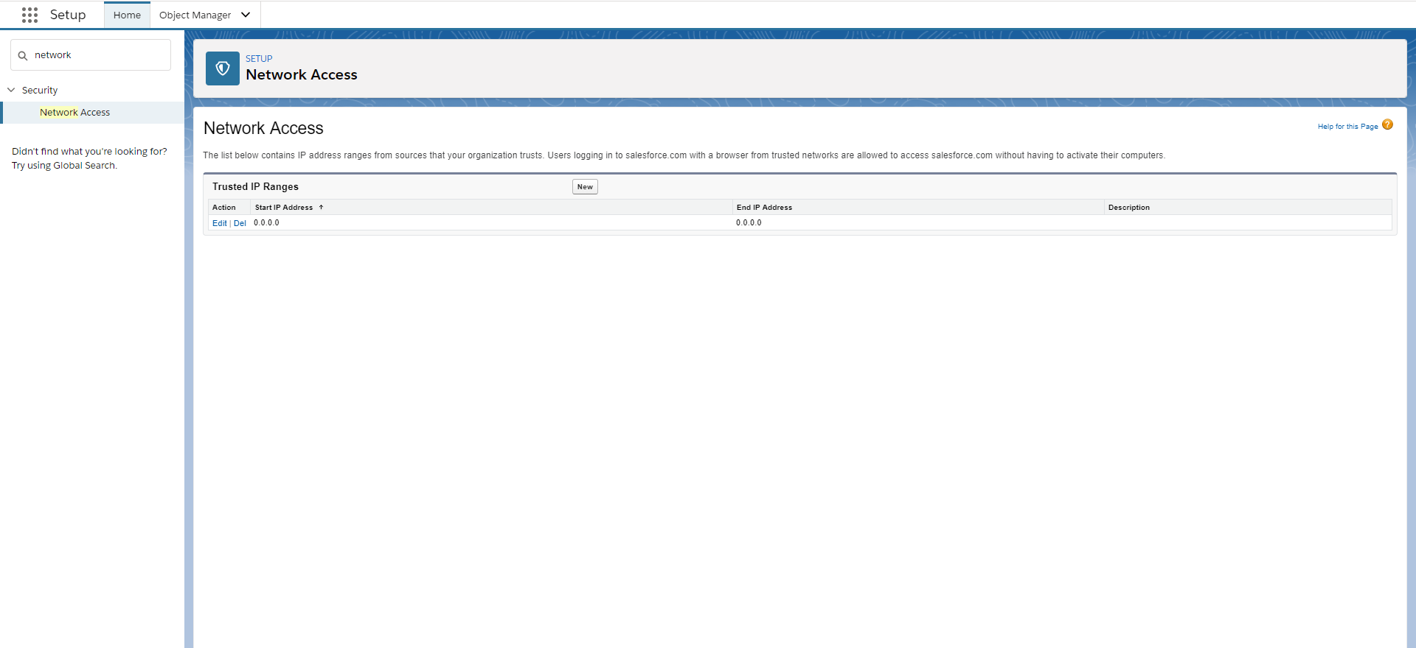
Used Trusted IP Ranges (in theory) 2FA, and Login Hours to make sure that the Bank Teller does most of their work on company time

Slide 7
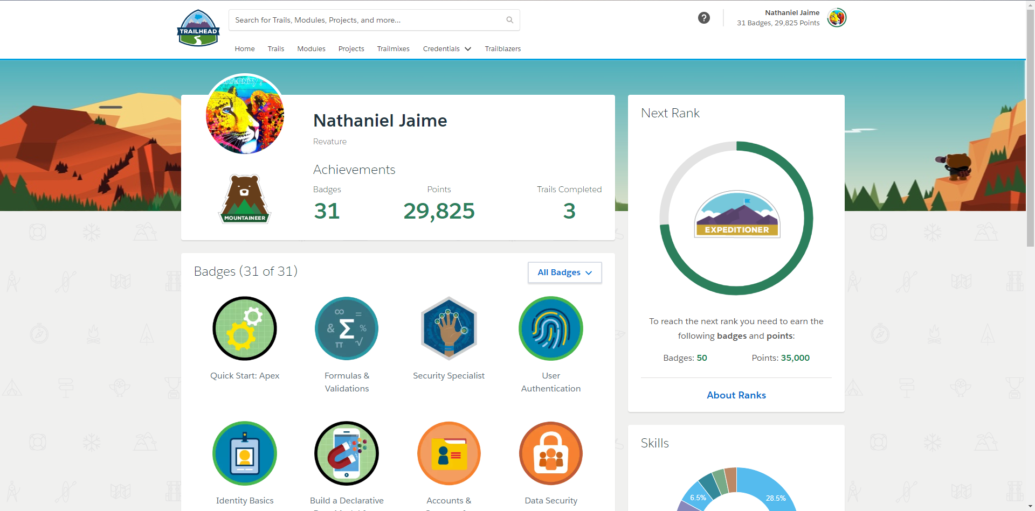

Slide 8
DEMO

